Slide 1
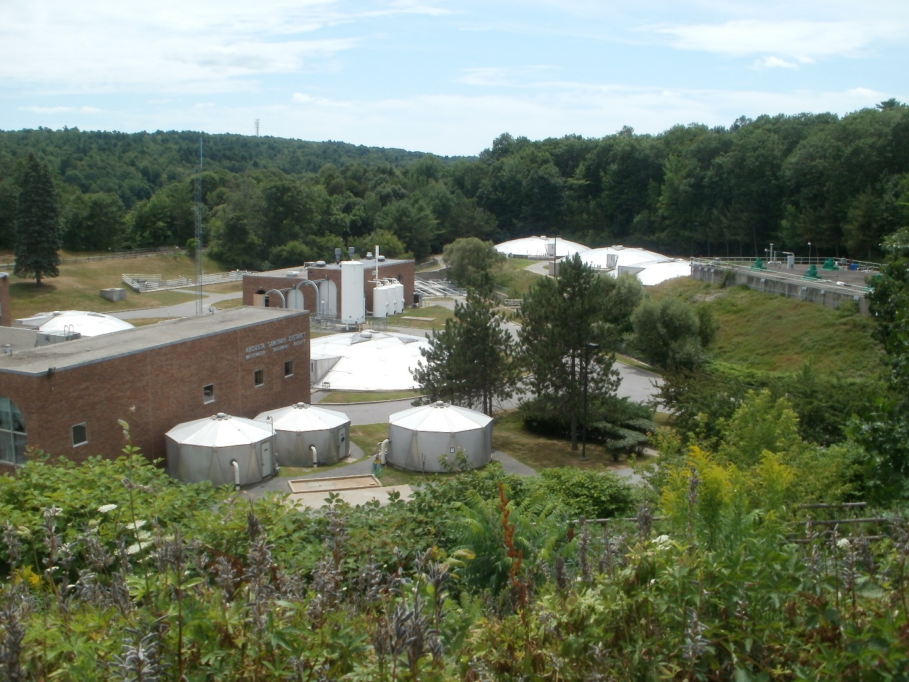
Greater Augusta utility district wastewater treatment facility

Slide 2
Who we are
Wastewater treatment plant Staff: operations, safety and laboratory
  over 100 combined years’ experience
  Dedicated to protecting the environment
  Continuing education via professional organizations and in-house training
  3 maine dep-certified grade V-b wastewater operators

Slide 3
Why we are here
To Remove pollutants from Incoming wastewater, 4 – 44 mgd
  commercial, residential and industrial sources
  Rain flows
  Snow melt
To Discharge treated, reclaimed water to the Kennebec river

Slide 4
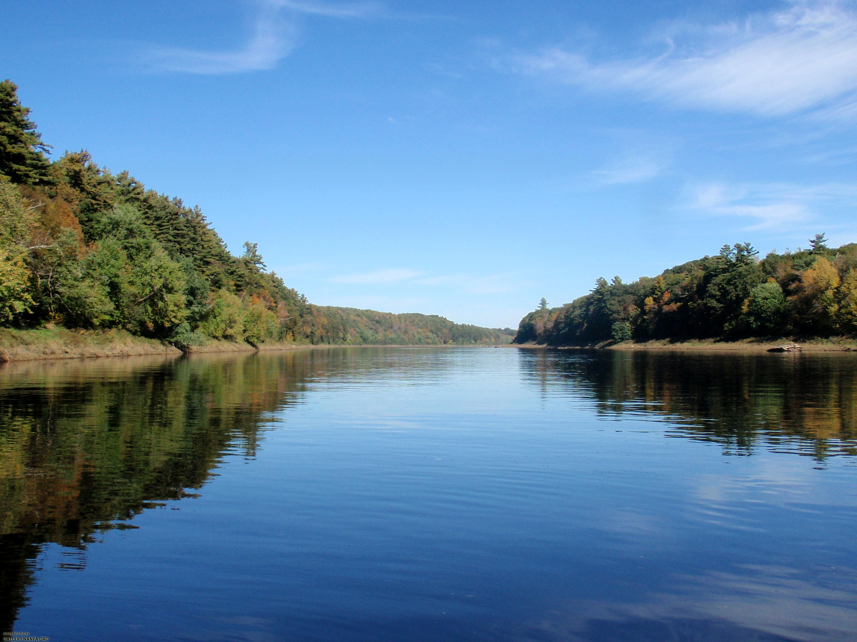
Maine pollutant discharge elimination system permitting (MEPDES) program
Administered by the maine department of environmental protection
All discharges to “waters of the state” must have a permit
Permit limits: based on “classification” of receiving water—

Slide 5
  Classification of Kennebec River:
  Class B
dissolved oxygen content not be less than 7 parts per million
suitable as a habitat for fish and other aquatic life. The habitat must be characterized as unimpaired.
Escherichia coli bacteria may not exceed 236 per 100 milliliters.
Discharges to Class B waters may not cause adverse impact to aquatic life

Slide 6
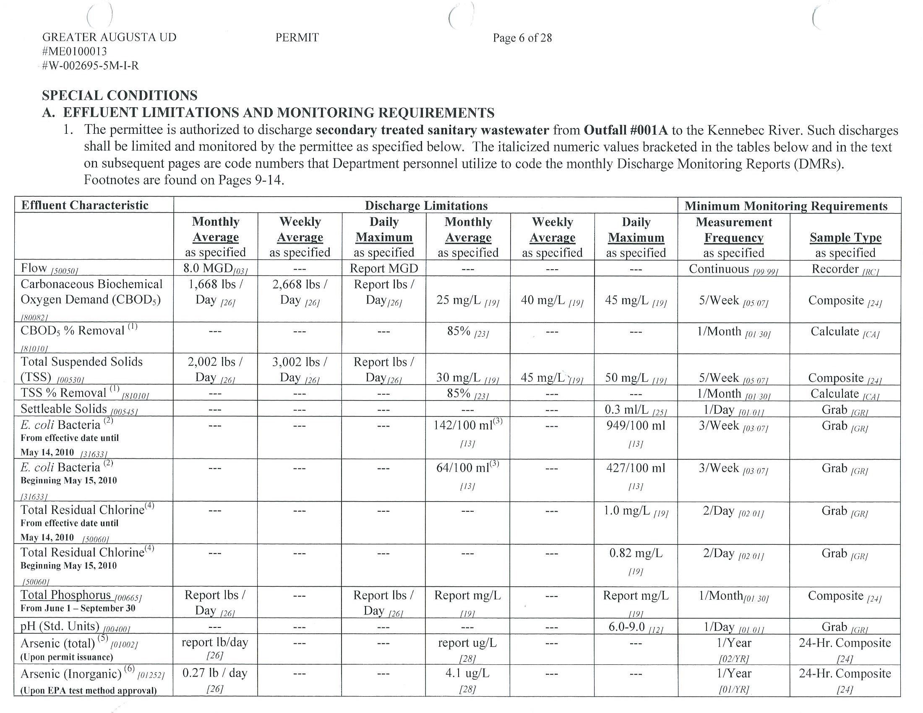
GAUD MEPDES Permit – Effluent Limitations

Slide 7
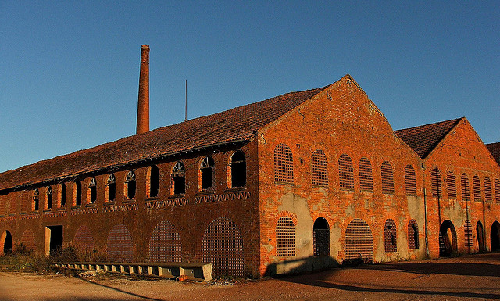
Where does flow come from?
Rain Events/Snow Melt
Residential
Industrial

Slide 8
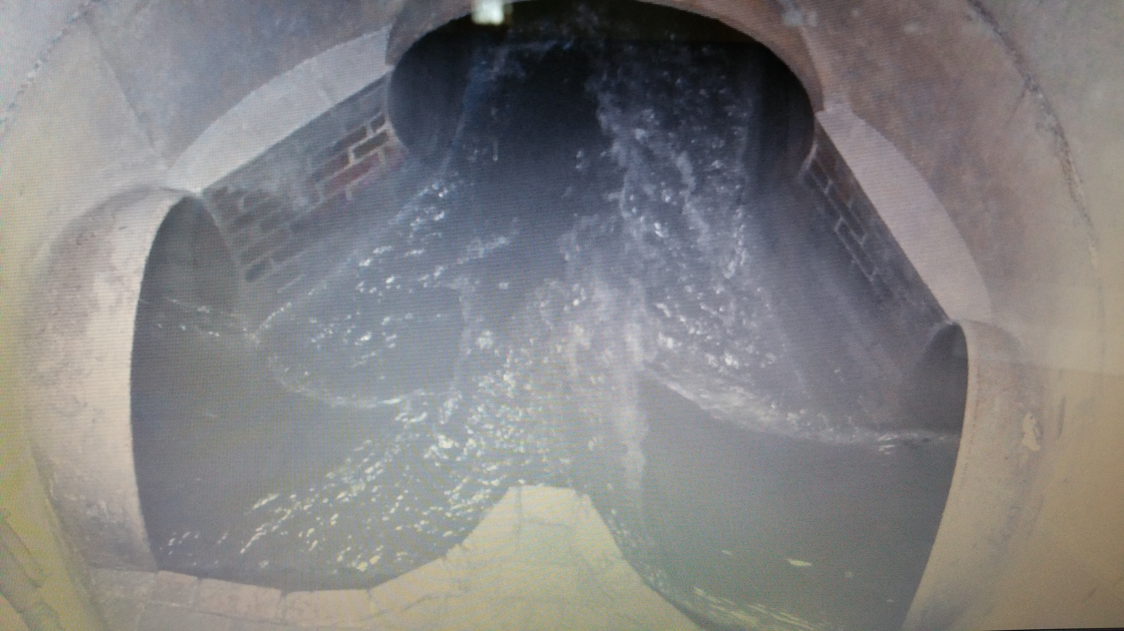
west/east side interceptors
TO HEADWORKS
EAST SIDE INTERCEPTOR
WEST SIDE INTERCEPTOR
WEST SIDE CONSOLIDATED CONDUIT

Slide 9
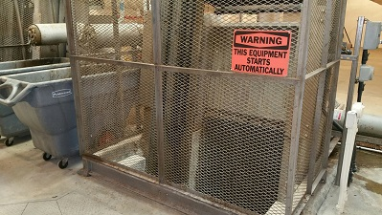
The Wastewater treatment process:
Preliminary treatment
Incoming Wastewater ("Influent")
New Bar Screen: Optimizes removal of sticks, rags, plastics, etc. (“Screenings”). Flow goes through grit chamber to FDS #1.
Bar Screen

Slide 10
The Wastewater treatment process:
Primary treatment
Primary Clarifier
Primary Treatment: Removal of floating (“scum”) and heavy solids (“Primary Solids”). Liquid goes to Flow Distribution Structure #2.

Slide 11
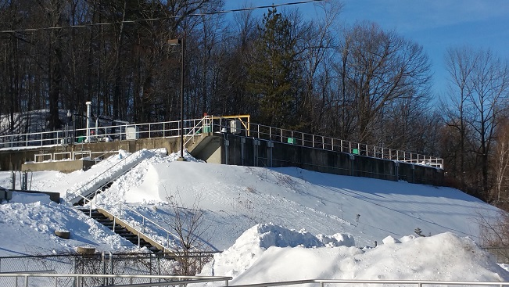
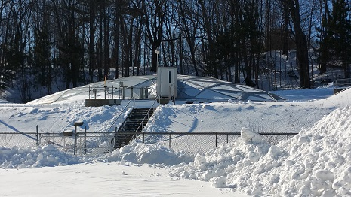
The Wastewater treatment process: secondary treatment
Secondary Treatment: Removal of dissolved and suspended solids (“Secondary Solids”) via bacterial activity (“Activated Sludge”). Requires Pure Oxygen.
Liquid from Aeration Tank goes to Secondary Clarifier.
Aeration Tank
Return Activated Sludge
Sludge Holding Tank
Primary
+
Secondary
Solids
Waste Activated Sludge
Secondary Clarifier

Slide 12
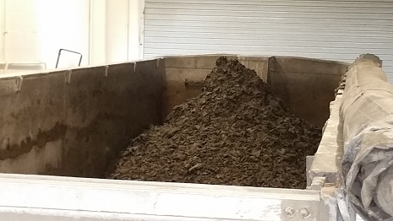
Primary + secondary solids = Biosolids composting: beneficial reuse
Dewatered Biosolids are hauled to A composting facility
Composting: “Process to further reduce pathogens”
The drier the solids, the lower the hauling fees
2015 Budget: $347,200 (Revised $295,850)
Projected 2015 Savings $51,000
2015 Jan – Mar = $73,741 ($81.98/ton)
2015 April – Dec = $222,108 (74.11/Ton)
Projected Budget for 2016 - $288,000
$72.00/ton 2016

Slide 13
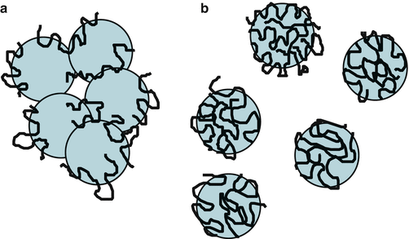
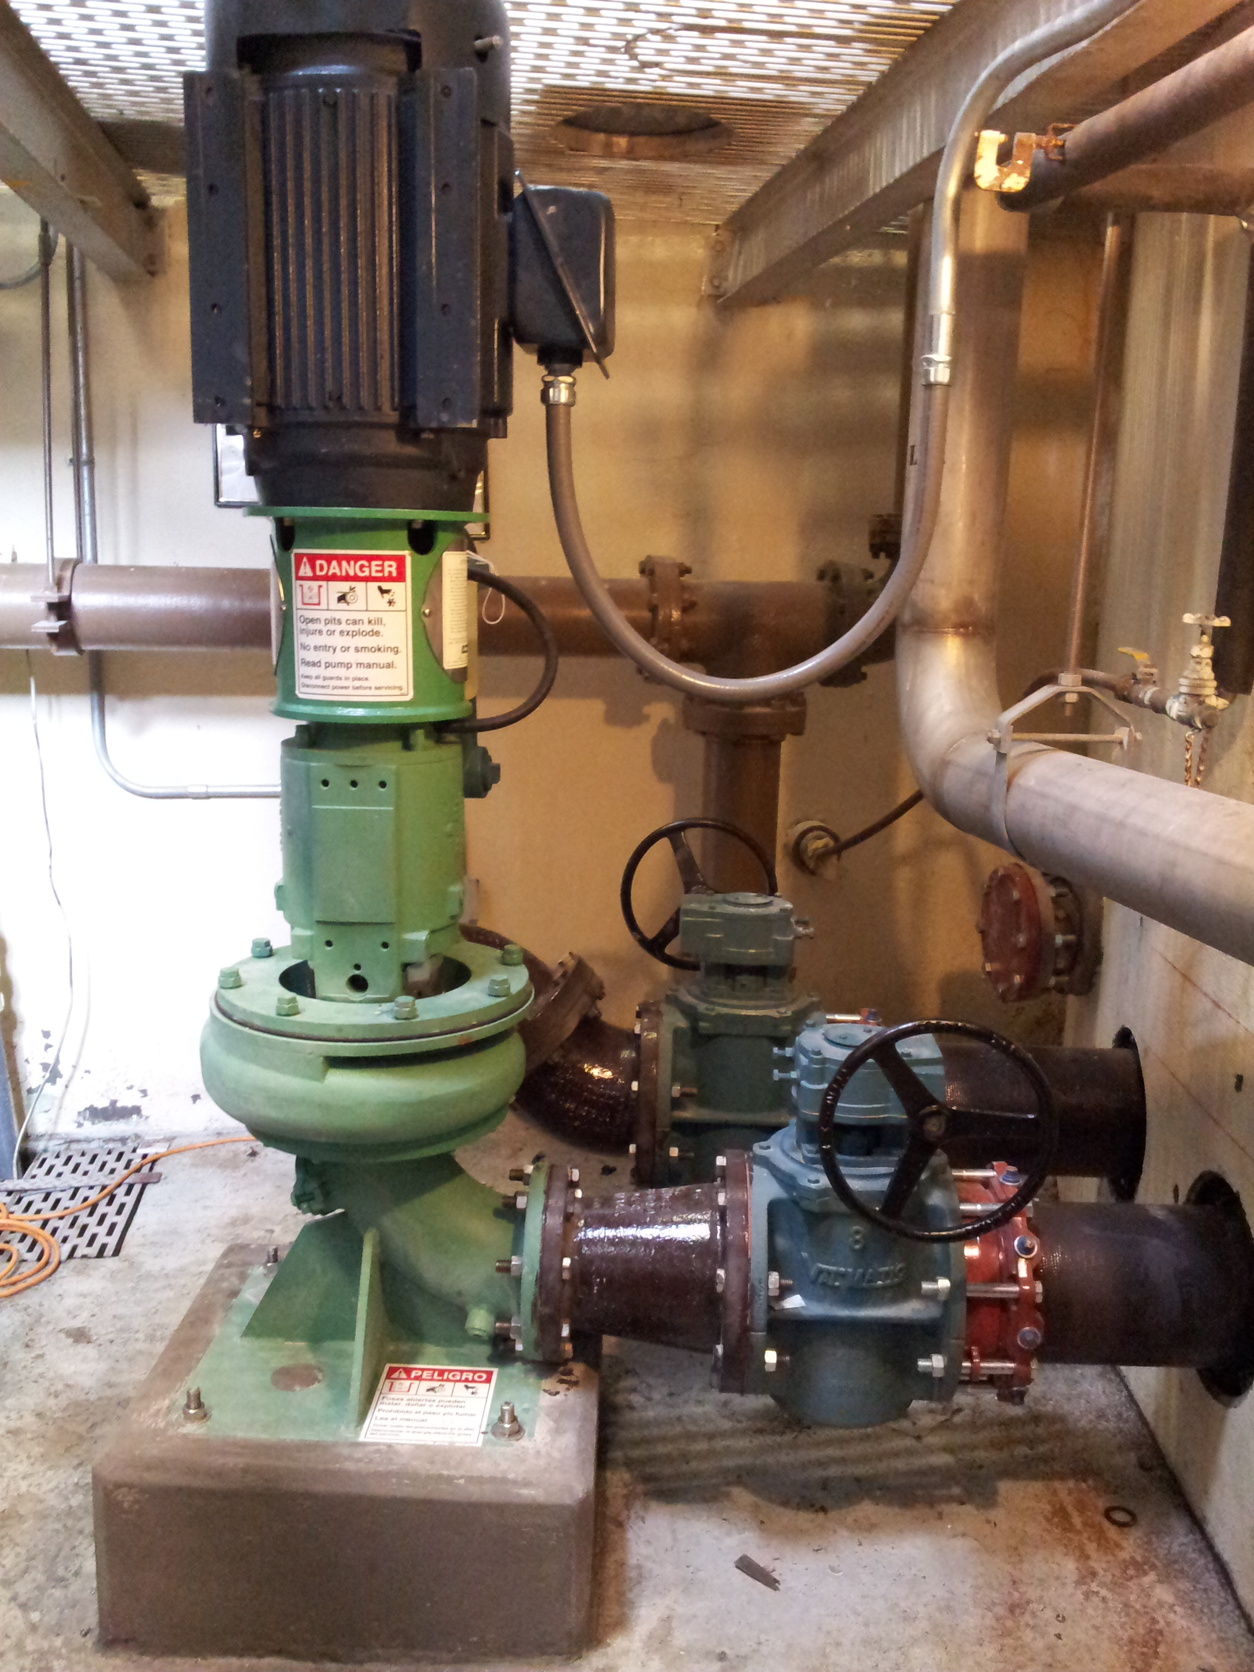
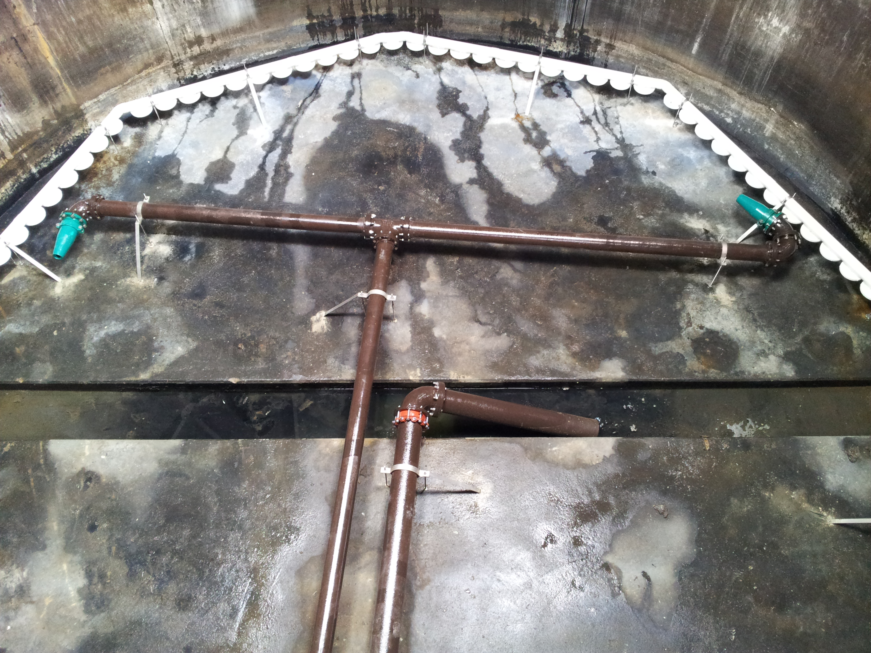
Dewatering process
To Reduce cost:
Thicken Waste activated sludge before it goes to sludge holding tank to reduce water content
Optimize polymer system to achieve best sludge floc
Assign personnel to run process efficiently
  This has helped reduce polymer use by 4000 lbs/yr saving $10,000
Installed Chopper Pump for sludge holding tank to mix and blend primary and thickened sludge to produce a better belt filter press feed sludge.
Floc with Polymer
Chopper Pump
Sludge Holding Tank #1

Slide 14
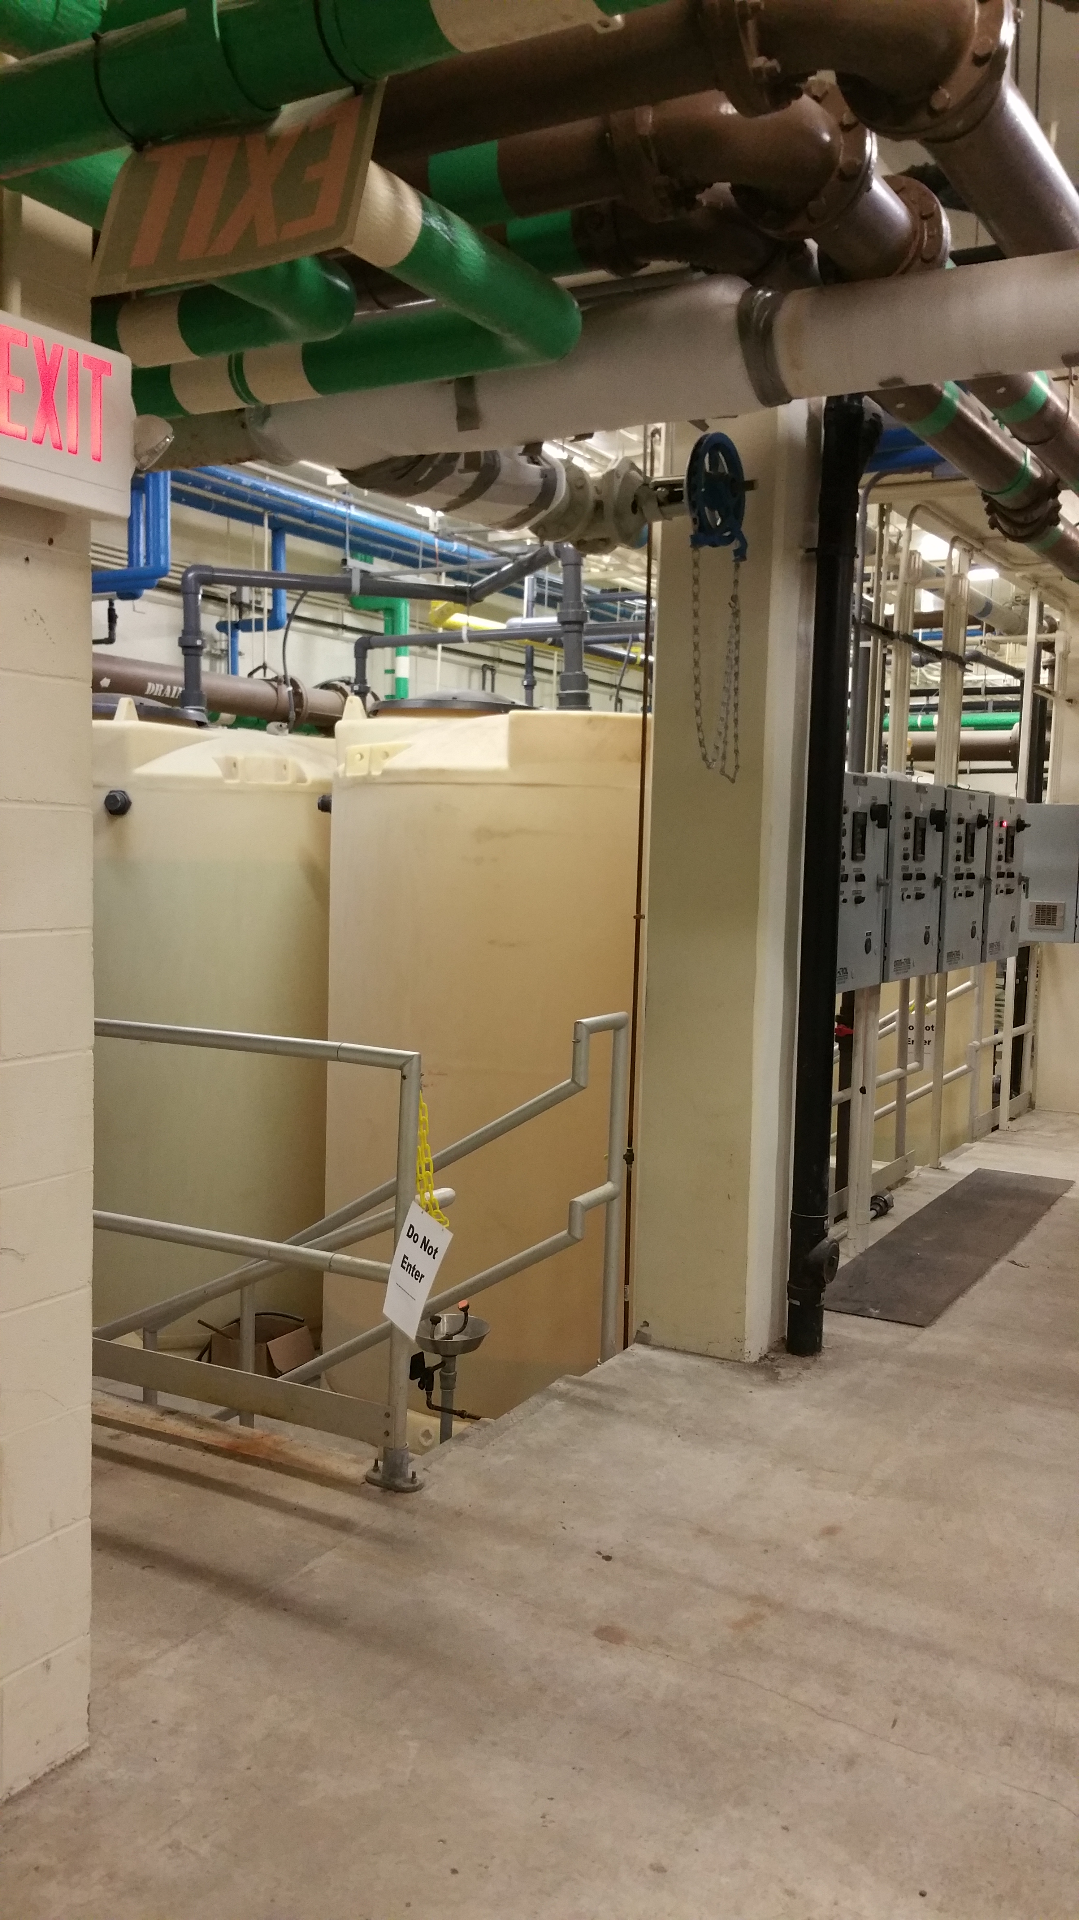
Chemical Use and Costs
Sodium Hydroxide 3411 gallons/yr $8,000
Sodium Hypochlorite 27,052 gallons/yr $27,000 (dependent on flow)
Sodium Bisulfite 5993 gallons/yr $19,000 (dependent on flow)
Liquid Oxygen 8400 gallons/yr $11,000
Defoamer 24 drums $8,000
Polymer 11,700 pounds $21,000
Total Chemical Budget 2015 - $106,000

Slide 15
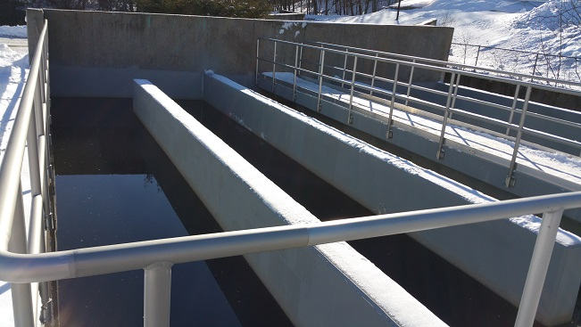
The Wastewater treatment process: effluent disinfection – Chlorination and dechlorination
Chlorine Contact Chamber
Disinfection: Reduction of disease-causing bacteria (“pathogens”)

Slide 16
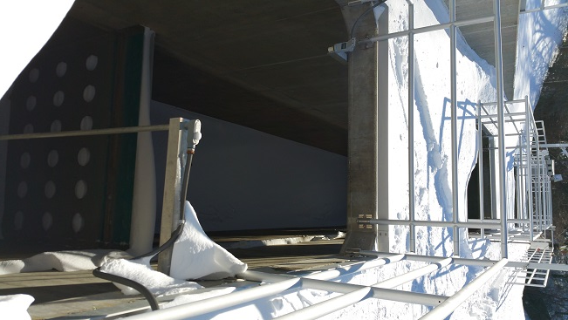
secondary bypass
(Bypass of the secondary wastewater treatment process)
High-Rate Disinfection Tank
Trigger:
  Instantaneous flows > 12 million gallons per day
Goes through primary treatment
Bypasses secondary treatment process
Disinfection in high-rate disinfection tank
Dechlorination in high-rate disinfection tank

Slide 17
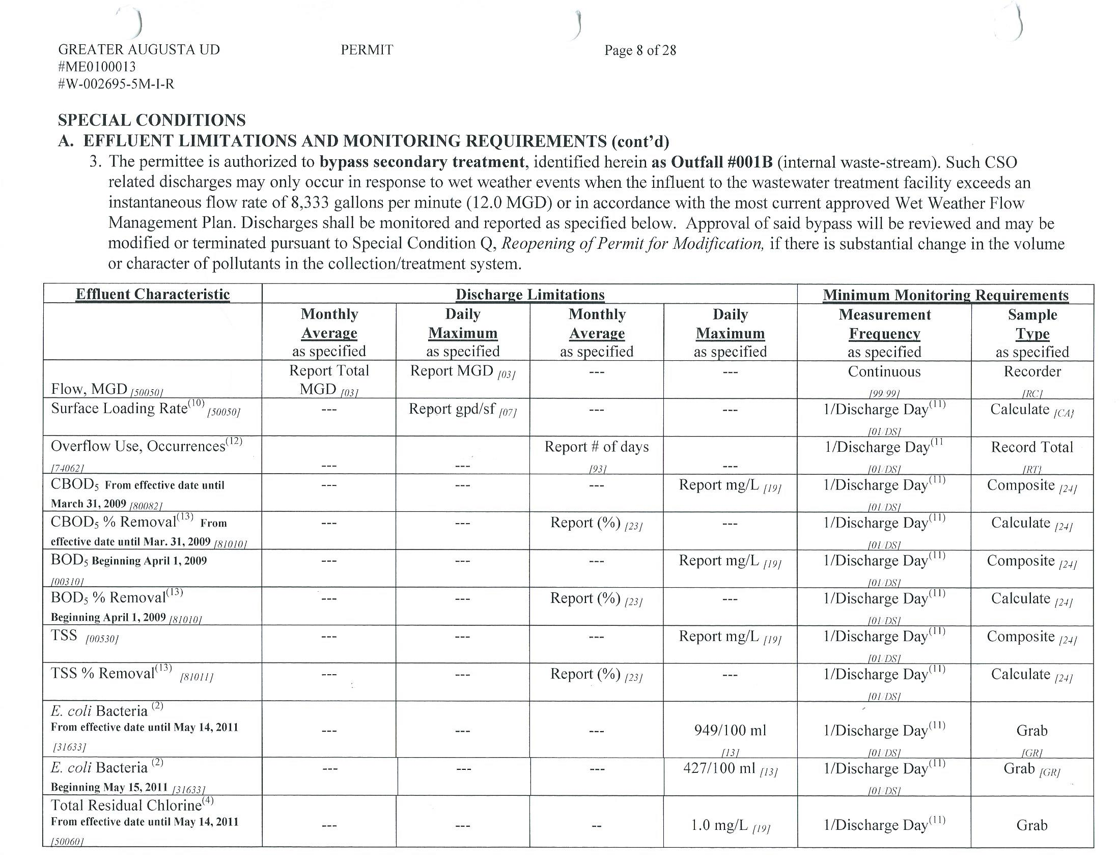
GAUD MEPDES Permit – Secondary Bypass Effluent Limitations

Slide 18
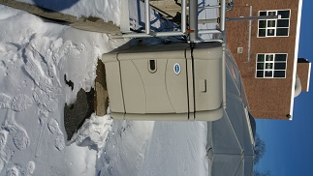
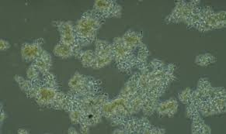
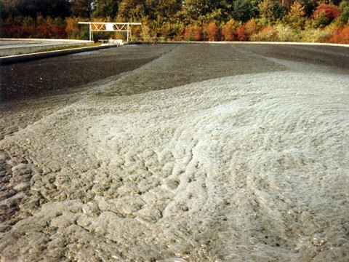
We can’t “Set it and forget it” process control is essential
Influent flow characteristics change constantly depending on many factors such as rain, spills, industrial and domestic discharges. Through process control personnel track these trends and adjust process control parameters.
Sampling/testing throughout wastewater treatment train
Microscopic examinations
Visual observations (colors, odors, foam)
Operator experience
Notes:
Influent flow characteristics change constantly depending on many factors. Through process control we track trends and react to changes to keep the biomass thriving.

Slide 19
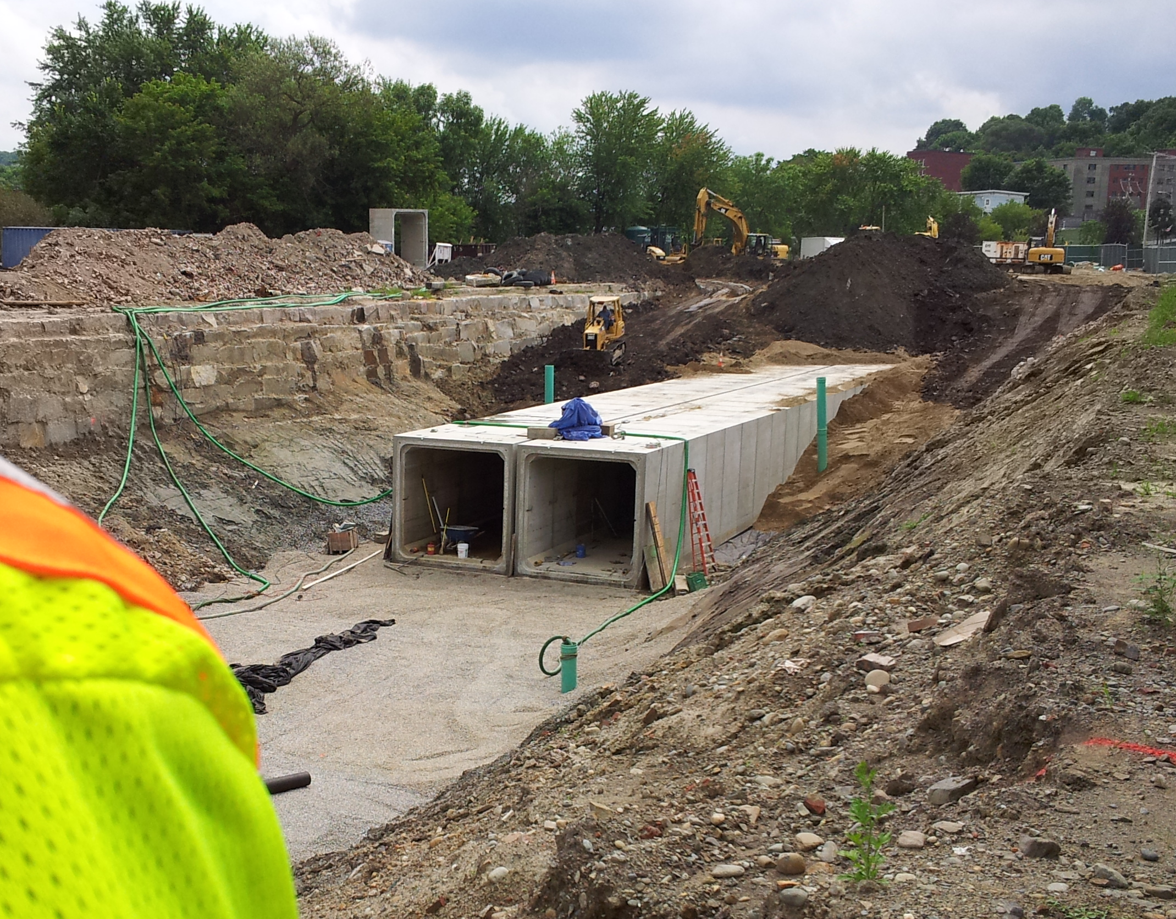
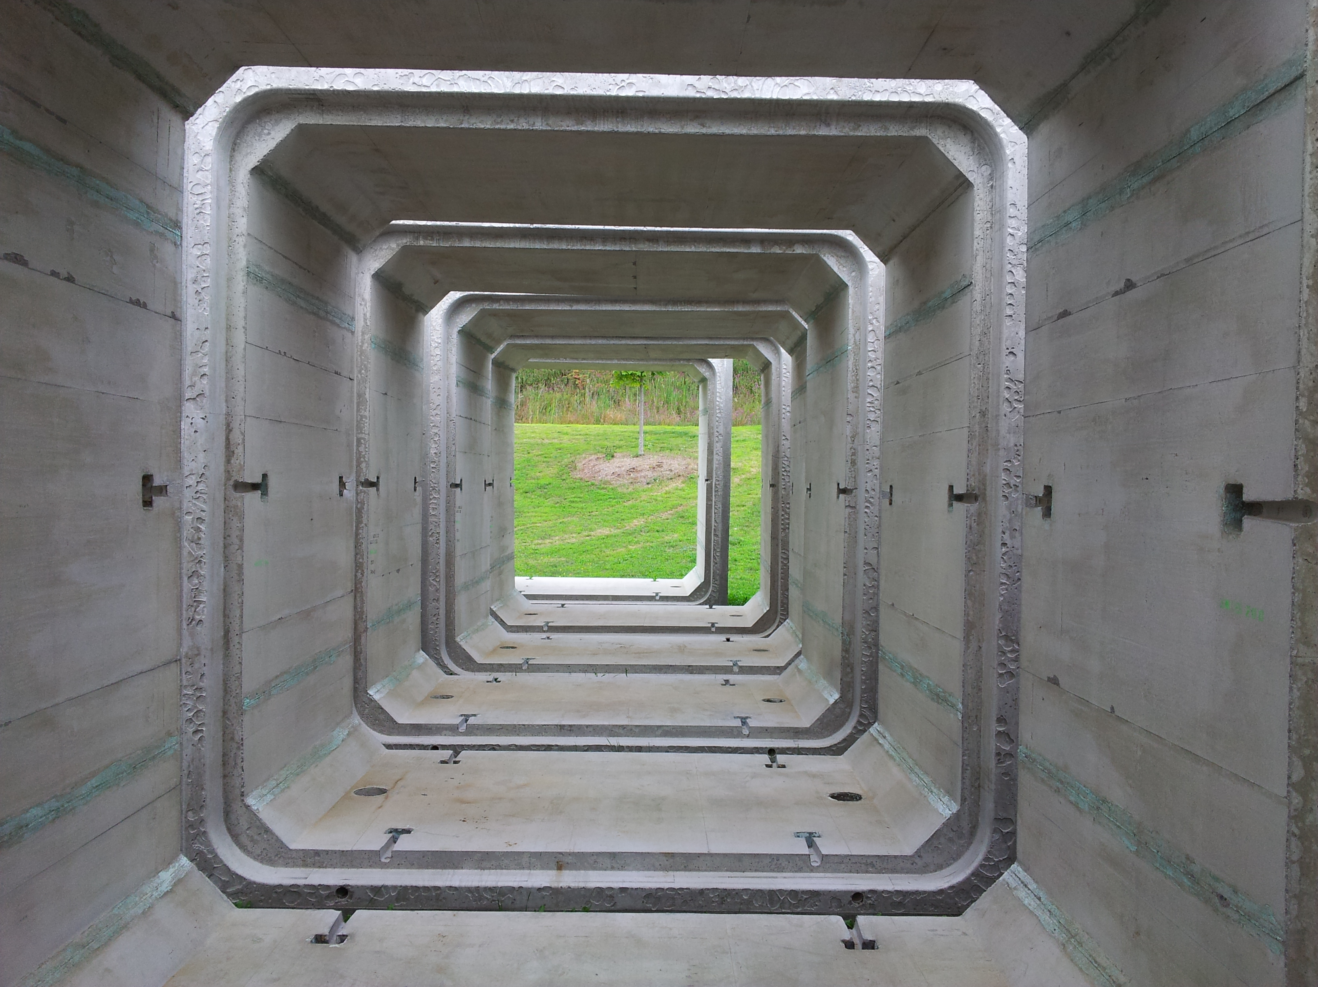
CSO Abatement
Projects
Phase I –1996 - CSO Abatement and Dewatering Improvements - $ 9,200,000
Phase II – 2001 – West Side Consolidated Conduit - $10,750,000
Phase III – 2011 – Bond Brook Collection System - $18,130,000
      Bond Brook Interceptor - $14,520,000
      CSO A1 and A2 - $1,610,000
      CSO III engineering $2,000,000
Total cost of CSO abatement to date: $44,046,539
Storage Conduit – Mill Park
Box Conduit

Slide 20
$ WWTP Cost-saving initiatives $
Item Initiative Savings
Mod rate reduction from 1.24 1.03 $15,000
Leader program score excellent $6,000
Schedule change reduced overtime $19,000
Heating fuel reduced use
Biosolids Reduced cost/Ton $40,000
(Budget Reduction)

Slide 21
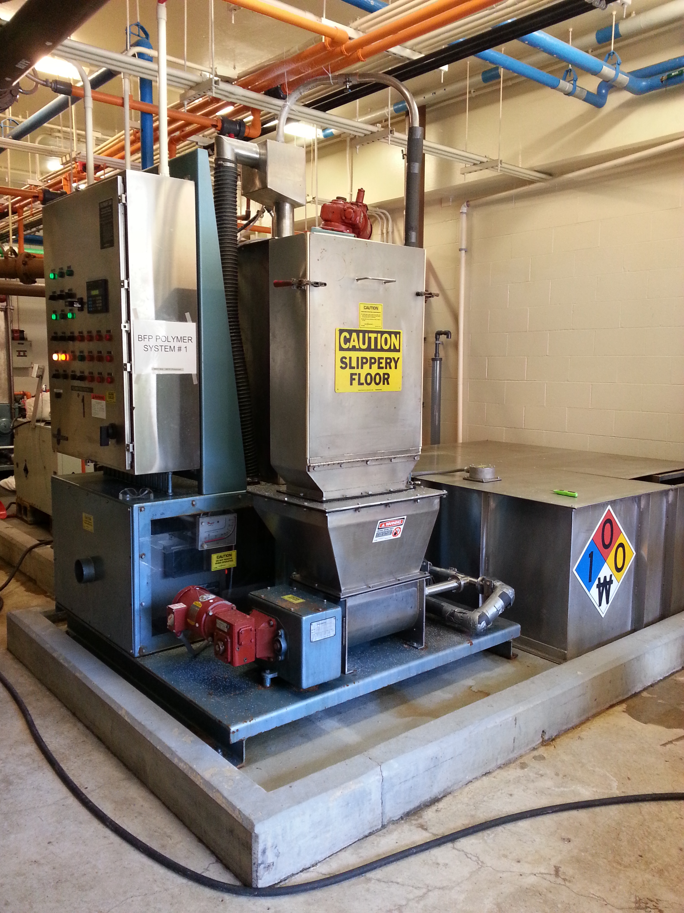
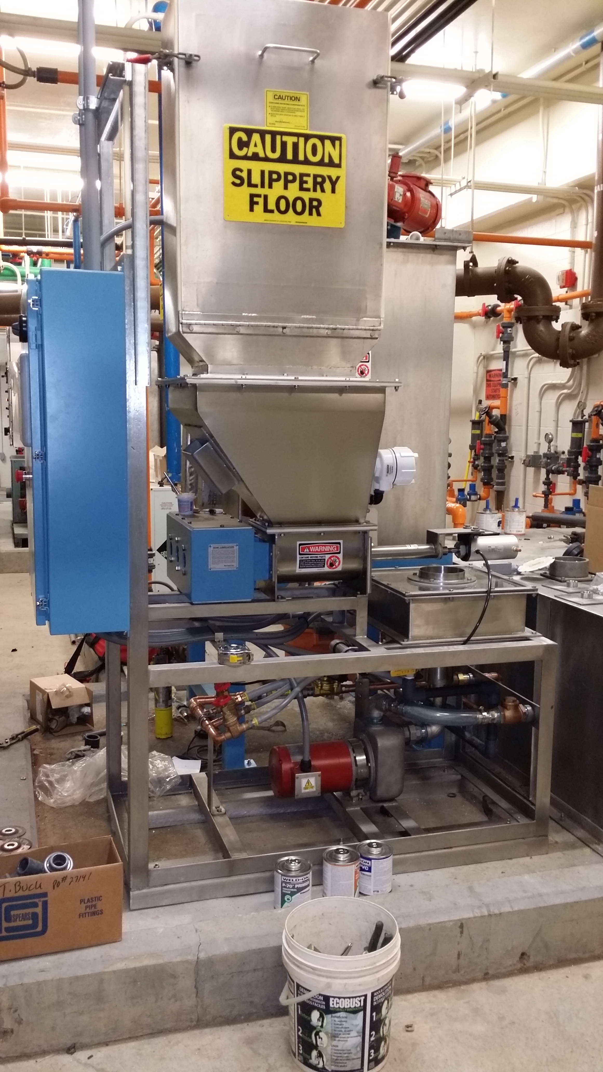
Projects completed in 2014
Two new acrison 515 polymer systems –
Cost $96,506 ($24,016 for labor and $72,490 for equipment)
      New systems Reduced polymer use by 1.6 lbs / batch saving $8,000/yr
Old Acrison 500 Polymer Systems
New Acrison 515 Polymer Systems

Slide 22
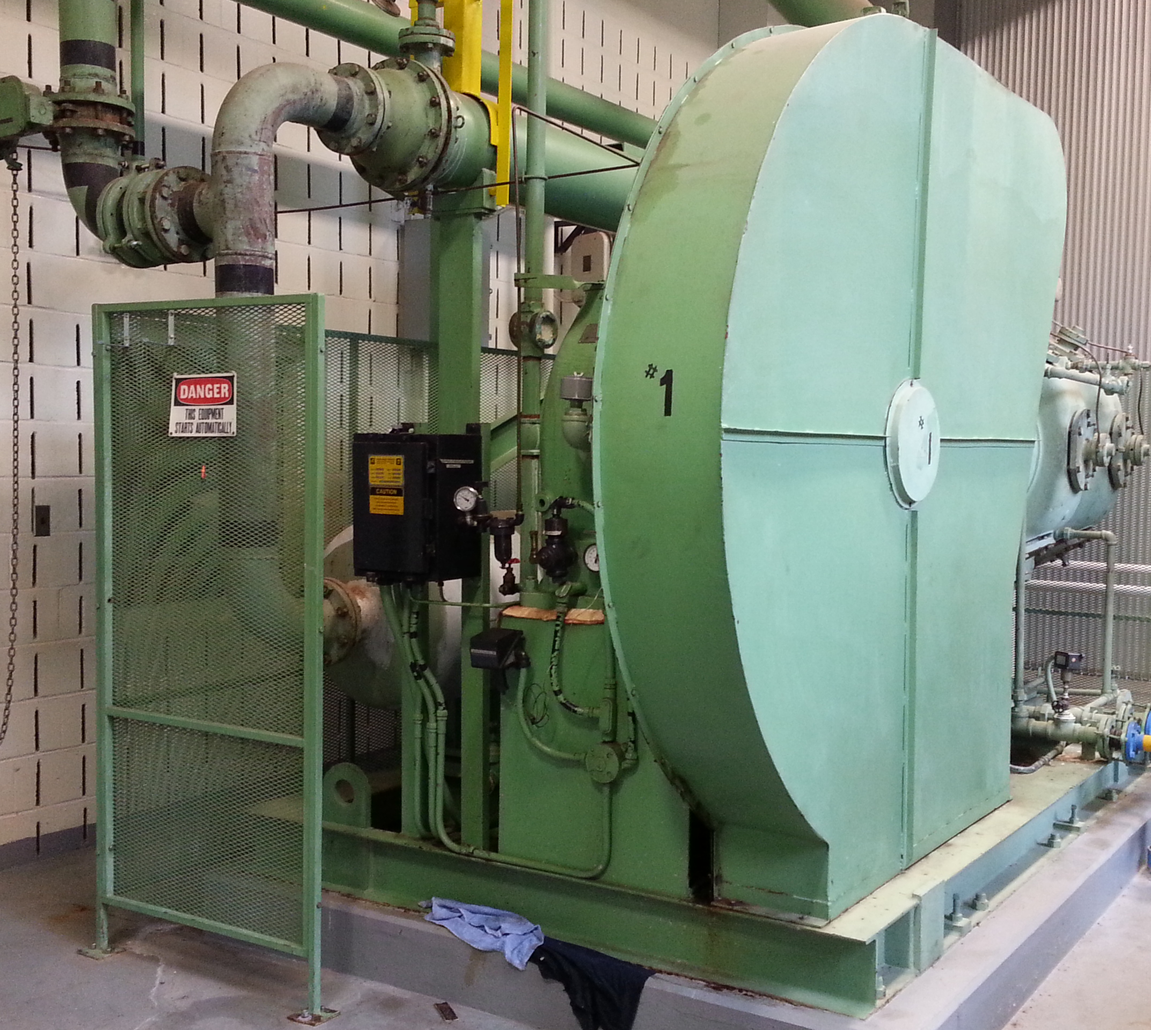
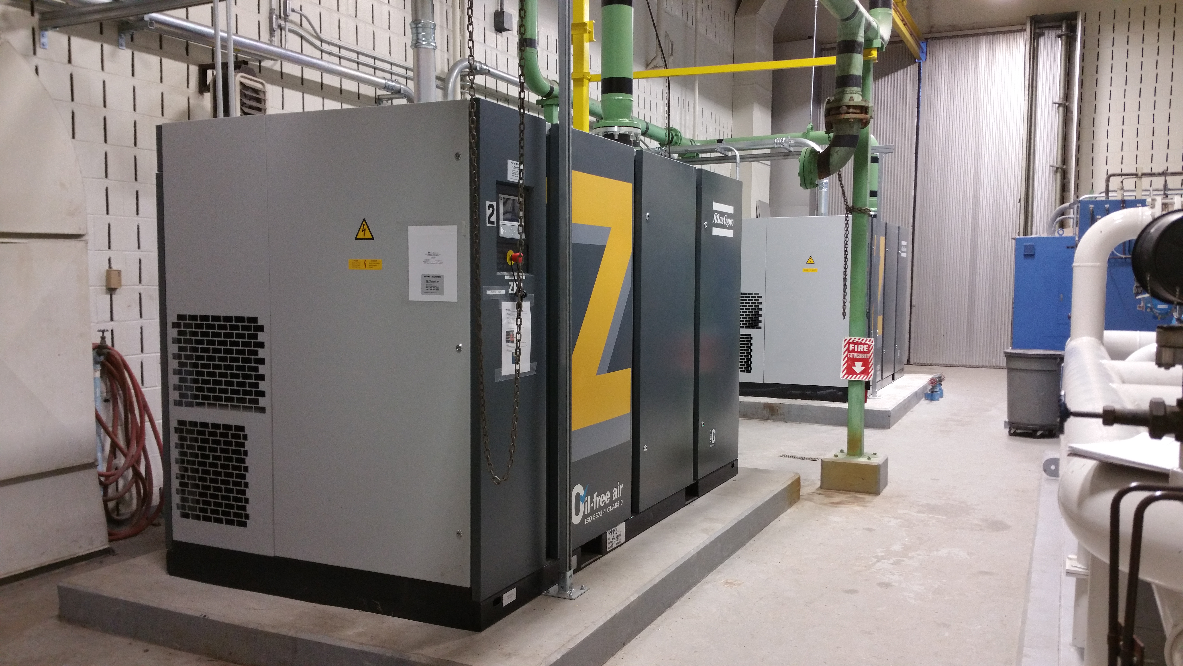
Projects completed in 2014
Two new 150 hp atlas copco compressors for the Pressure swing Absorbtion (PSA) system Cost $256,500 ($221,084 for equipment and $ 35,416 for labor)
        Reduced hp from 250 to 150
Original 250 HP Compressor
150 HP Atlas Copco Compressors

Slide 23
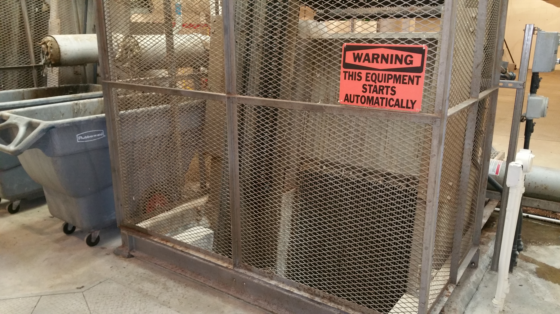
Projects completed in 2014
Reduced bar rack bar width from 1 inch to ½ inch –
  cost $72,162
    This will reduce the amount of debris allowed to pass through
      reduces damage to equipment down stream
      Reduces maintenance cost
½ Inch
1 Inch
Bars

Slide 24
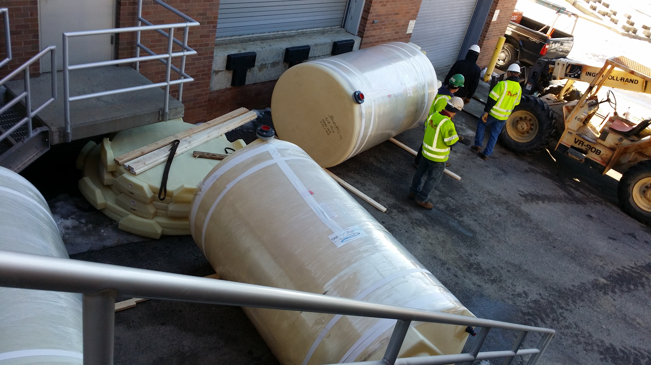
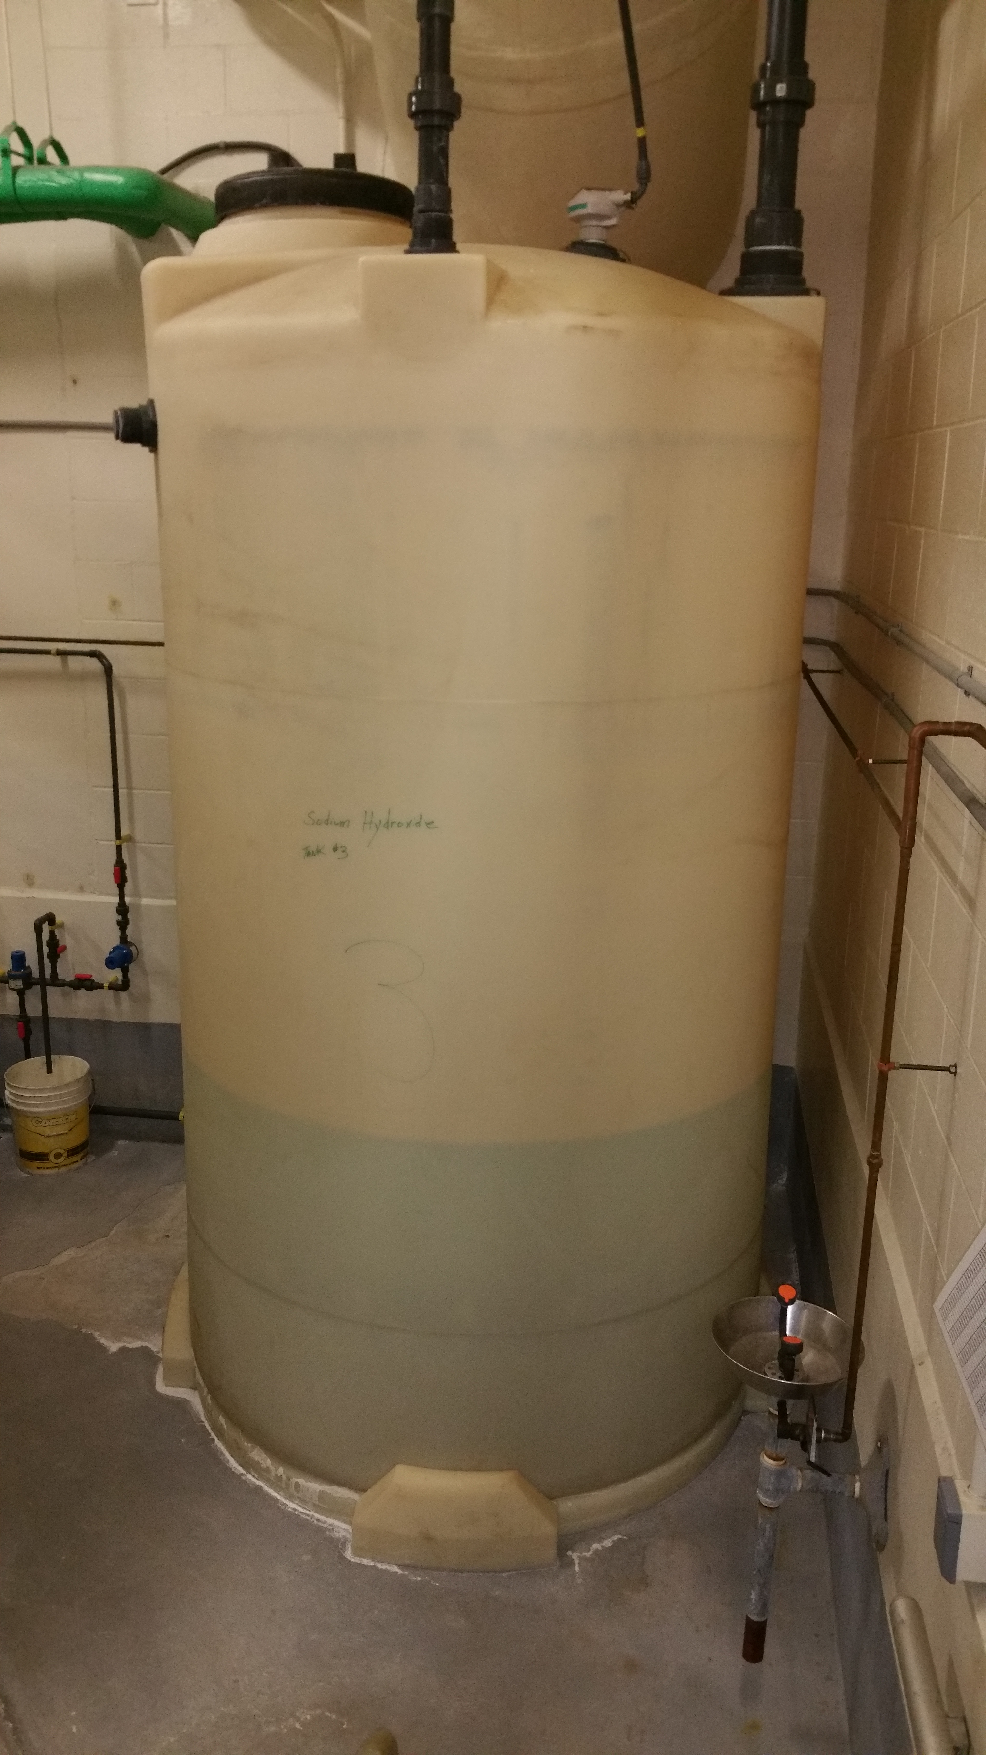
Projects completed in 2014
Installed 6 new bulk storage chemical tanks
Cost $126,636 ($50,165 for equipment, $ 37,616 for labor and $38,855 for the piping change order)
      Provides more storage for chemicals needed for high flow events and replace 34 old tanks and piping

Slide 25
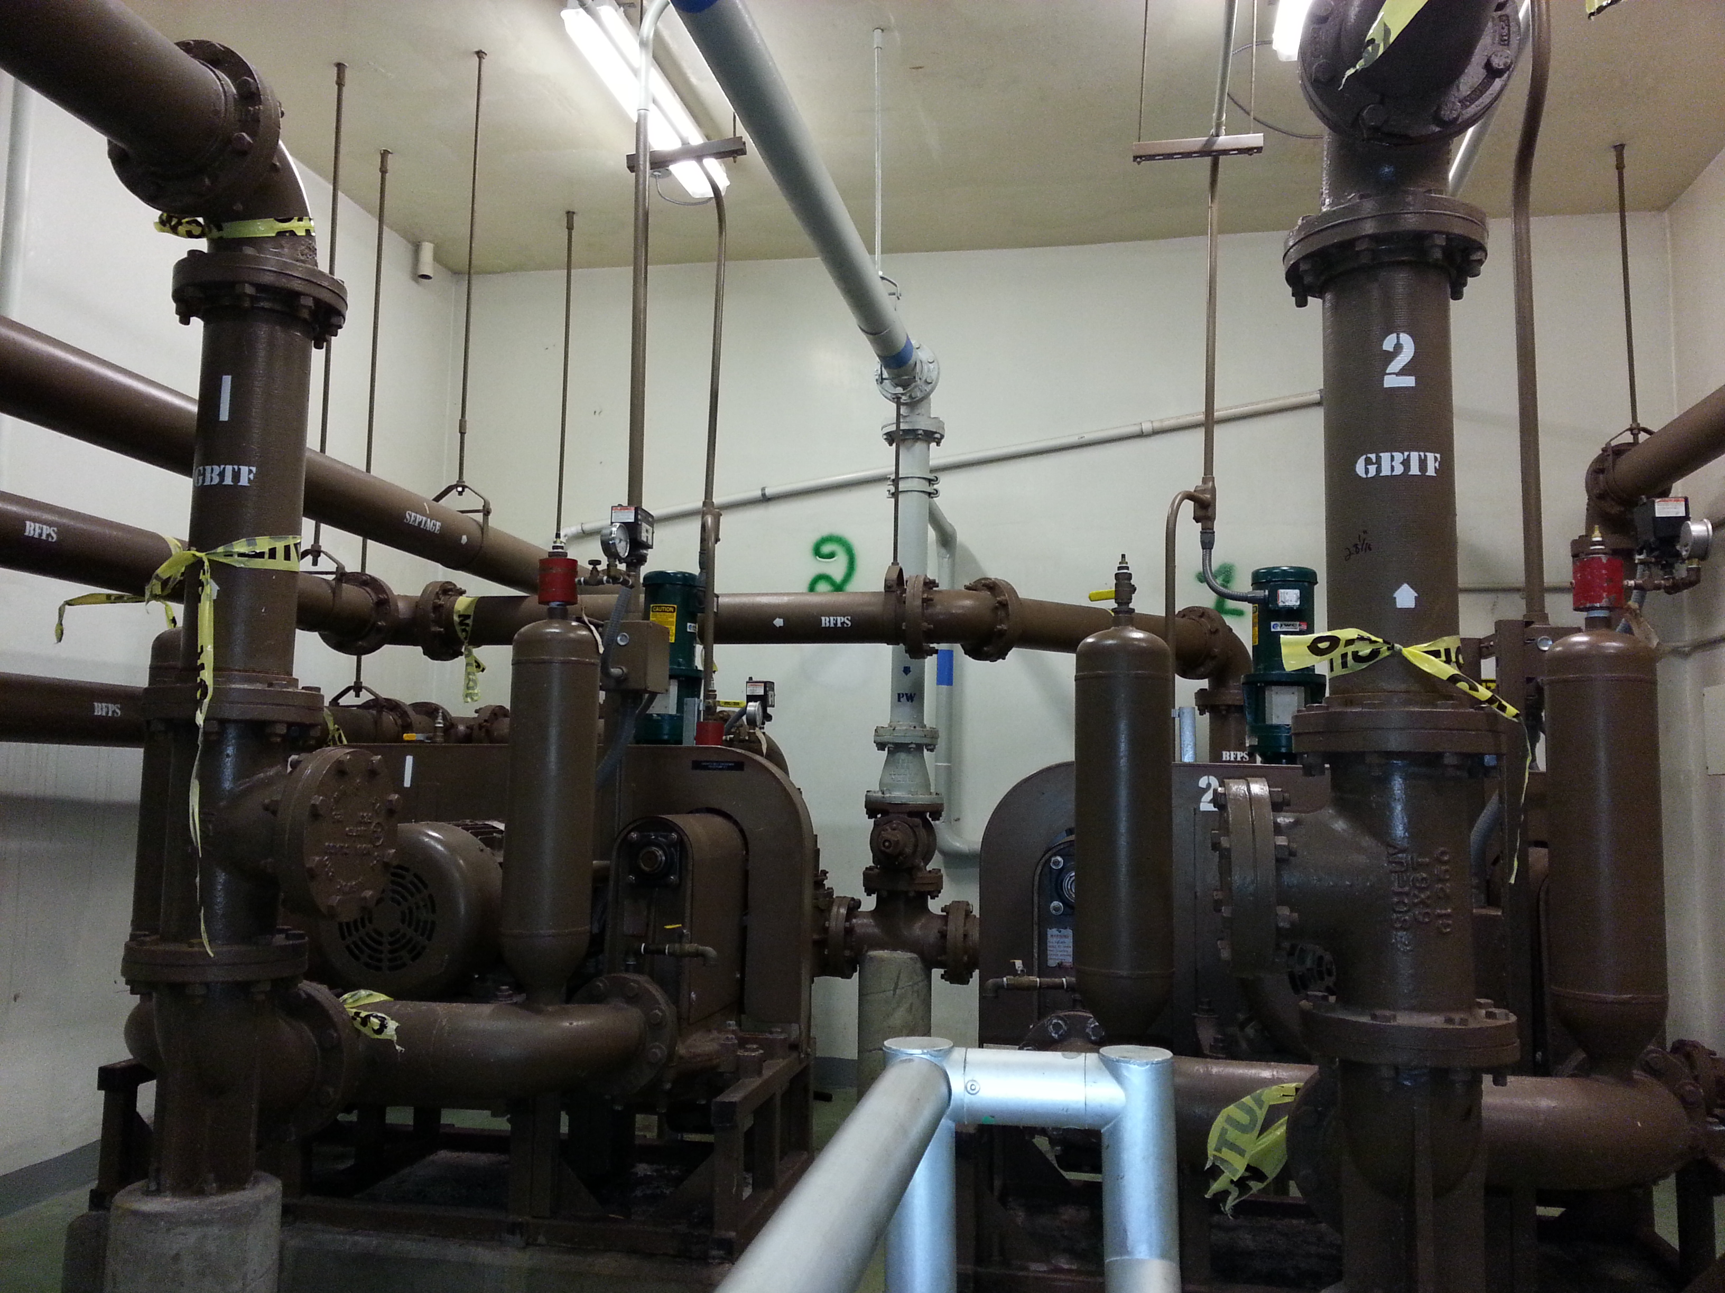
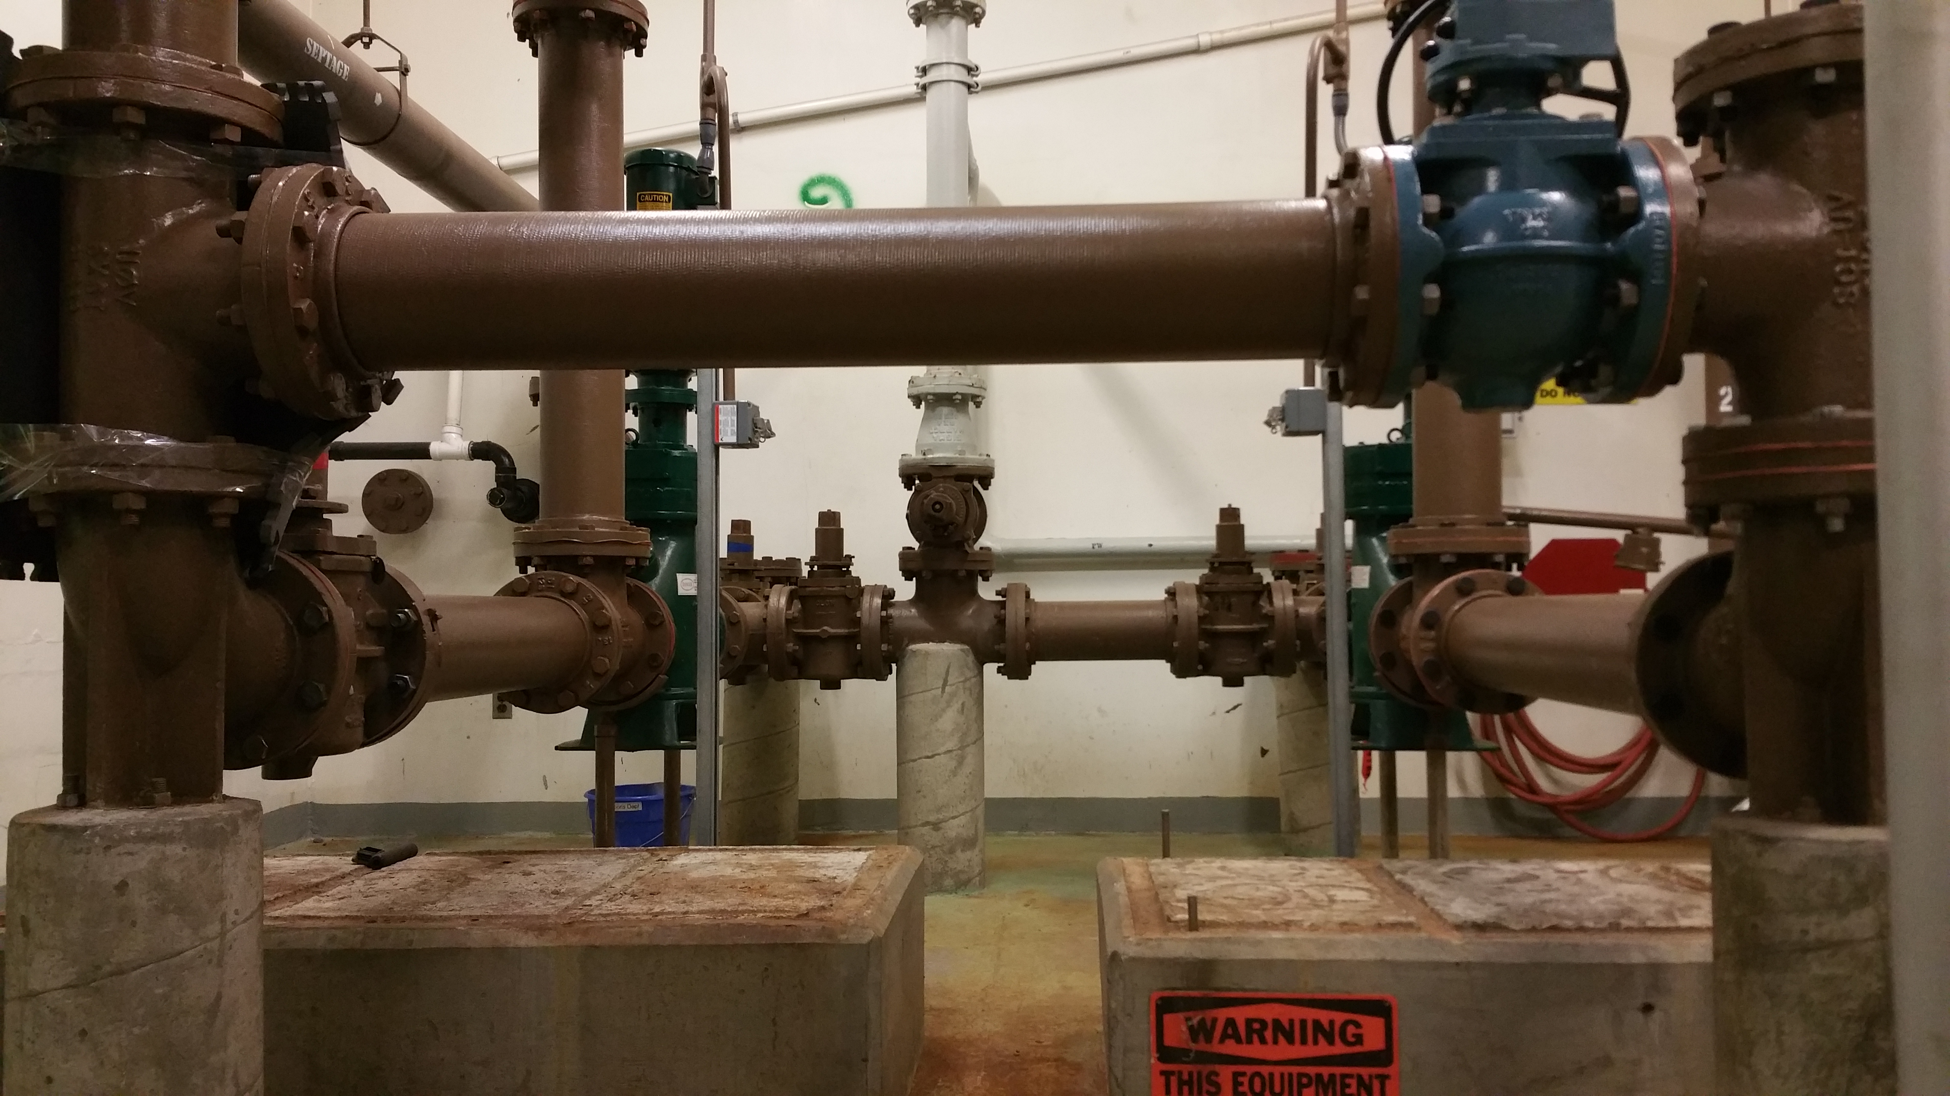
Projects completed in 2014
Installed rotary lobe waste activated sludge pumps and remove 2 penn valley gravity belt thickener (gbt) pumps
Cost $27,658
      Installed larger waste activated sludge pumps with the capacity to pump to the gravity belt thickener so 4 – 34 yr old pumps could be removed
      Reduces cost by saving on maintenance, power and eventual replacement
Gravity Belt Thickener (GBT) Pumps

Slide 26
Summary of 2014 projects
Total Cost of 2014 WWTF Projects: $563,310
Staff ordered all equipment to save on contractor mark-up
All metal from the construction was recycled
Supplier Submitted an application for an efficiency maine grant for compressors
Replaced 34-year-old equipment
New equipment should have a 20-year service life

Slide 27
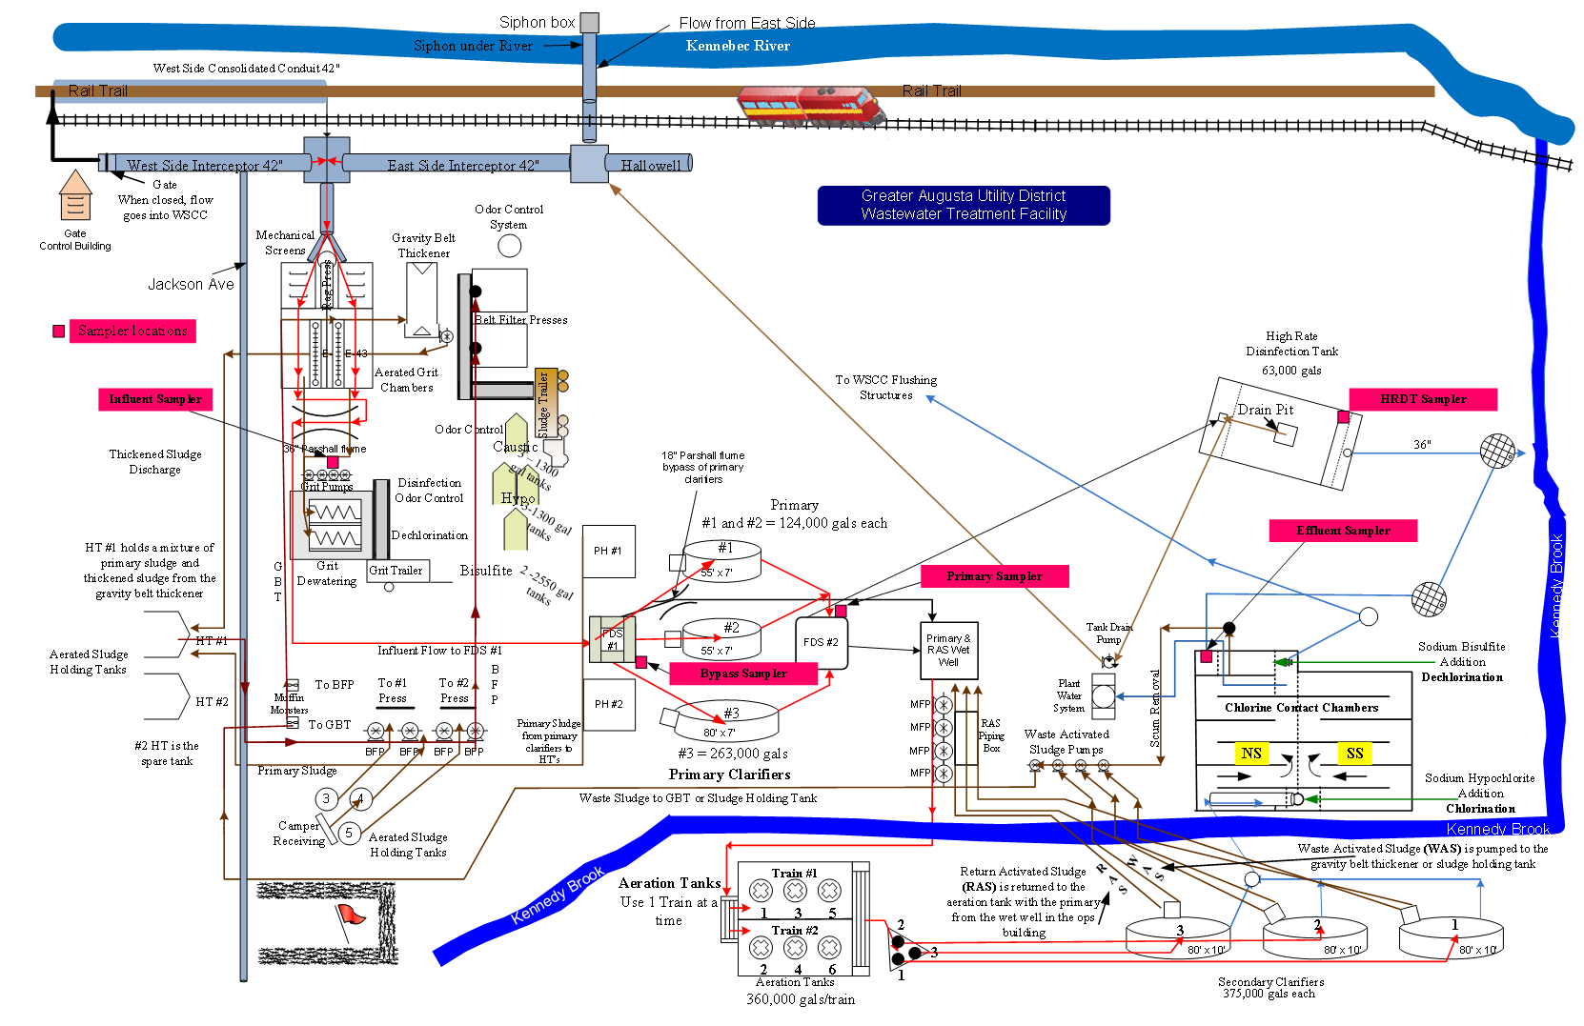


Slide 28
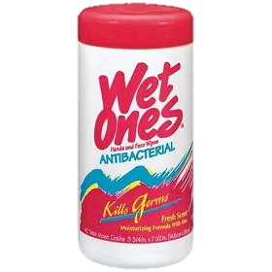

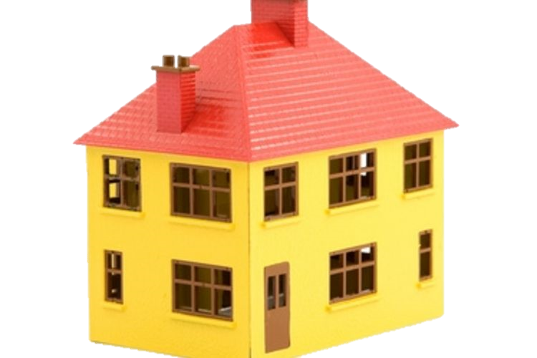

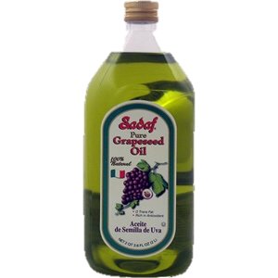
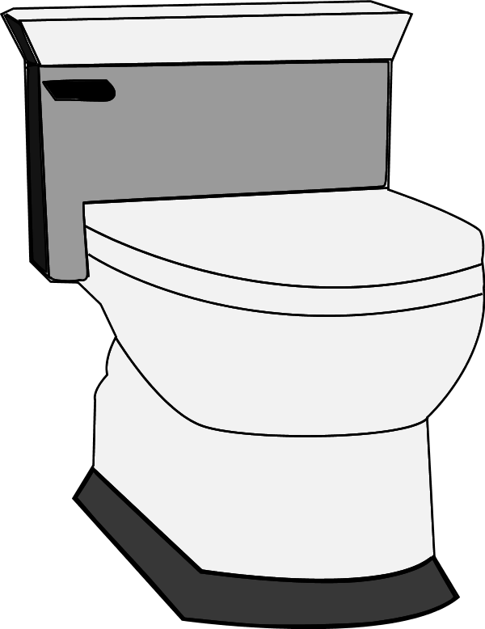
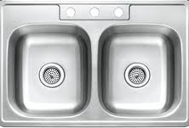

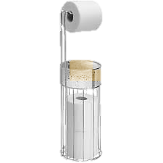
Summary
Residential
NO FATS, OIL OR GREASE
NO WIPES
WWTF

Slide 29
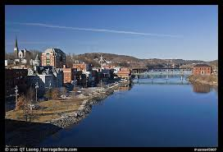

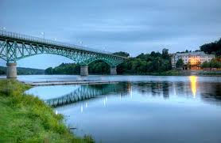
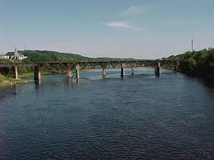

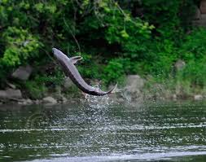
Discharge of treated water to the Kennebec river

